Slide 1


Prakrati Gupta
19/09/2021

Slide 2

Outline
Executive Summary
Introduction
Methodology
Results

Slide 3
Executive Summary
Methodologies
Need to analysis the price of each launch and the success rate of each launch
Summary of all results
The trained machine learning model and use the data from SpaceX to determine if space will reuse the first stage and success rate of each launch in SpaceY.

Slide 4
Introduction
Project background and context
SpaceY will be sending spacecraft from international International space station. The SpaceY will be competing with SpaceX founded by Ellen Mask.
SpaceY will analysis the data of SpaceX and will come to a result or summary about how to the first stage of landing and reuse the first stage.
Problems you want to find answers
There will be below answers need to find out
Success rate of each launch.
If SpaceX will reuse the first stage.

Slide 5


Slide 6
Methodology
Executive Summary
Data collection methodology:
Perform data wrangling
Perform exploratory data analysis (EDA) using visualization and SQL
Perform interactive visual analytics using Folium and Plotly Dash
Perform predictive analysis using classification models

Slide 7
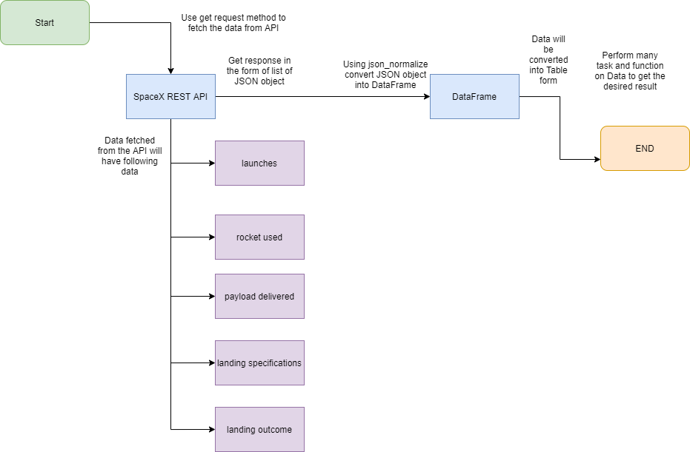
Data Collection – SpaceX API
We will be working with SpaceX launch data that is gathered from an API, specifically the SpaceX REST API. This API will give us data about launches, including information about the rocket used, payload delivered, launch specifications, landing specifications, and landing outcome.
The SpaceX REST API endpoints, or URL, starts with api.spacexdata.com/v4/. We have the different end points, for example: /capsules and /cores We will be working with the endpoint api.spacexdata.com/v4/launches/past.
GitHub URL
Place your flowchart of SpaceX API calls here

Slide 8
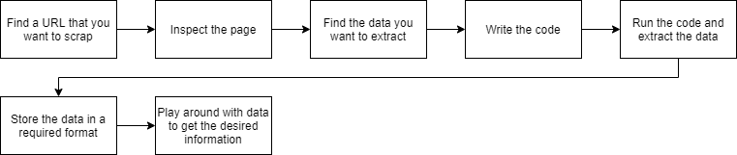
Data Collection - Scraping
Imagine you have to pull a large amount of data from websites, and you want to do it as quickly as possible. How would you do it without manually going to each website and getting the data? Well, “Web Scraping” is the answer. Web Scraping just makes this job easier and faster.
GitHub URL

Slide 9
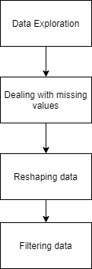
Data Wrangling
Data Wrangling is the process of gathering, collecting, and transforming Raw data into another format for better understanding, decision-making, accessing, and analysis in less time.
Data Wrangling is a crucial topic for Data Science and Data Analysis. Pandas Framework of Python is used for Data Wrangling. Pandas is an open-source library specifically developed for Data Analysis and Data Science. The process like data sorting or filtration, Data grouping, etc.
GitHub URL

Slide 10
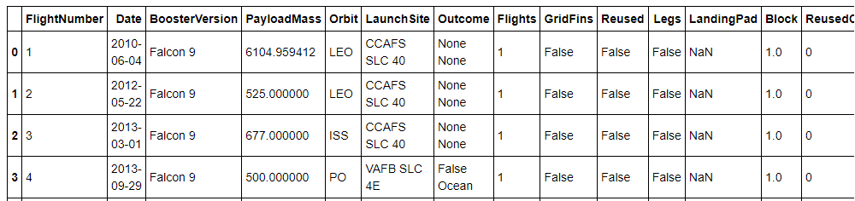
EDA with Data Visualization
EDA – Exploratory Data Analysis
Exploratory Data Analysis refers to the critical process of performing initial investigations on data to discover patterns, to spot anomalies, to test hypothesis and to check assumptions with the help of summary statistics and graphical representations.
GitHub URL

Slide 11
EDA with SQL
Exploratory Data Analysis refers to the critical process of performing initial investigations on data to discover patterns, to spot anomalies, to test hypothesis and to check assumptions with the help of summary statistics and graphical representations.
GitHub URL

Slide 12
Build an Interactive Map with Folium
Folium is a Python library used for visualizing geospatial data. It is easy to use and yet a powerful library. Folium is a Python wrapper for Leaflet.js which is a leading open-source JavaScript library for plotting interactive maps
Markers are the items used for marking a location on a map. For example, when you use Google Maps for navigation, your location is marked by a marker and your destination is marked by another marker. Markers are among the most important and helpful things on a map.
Folium gives a folium. Marker() class for plotting markers on a map. Just pass the latitude and longitude of the location, mention the popup and tooltip and add it to the map.
GitHub URL

Slide 13
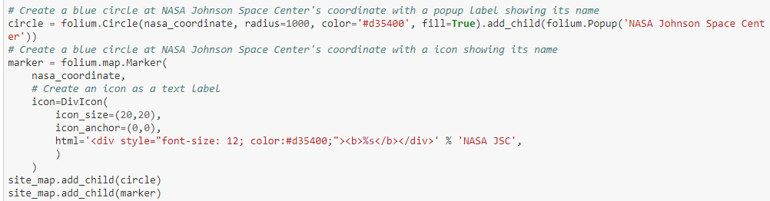
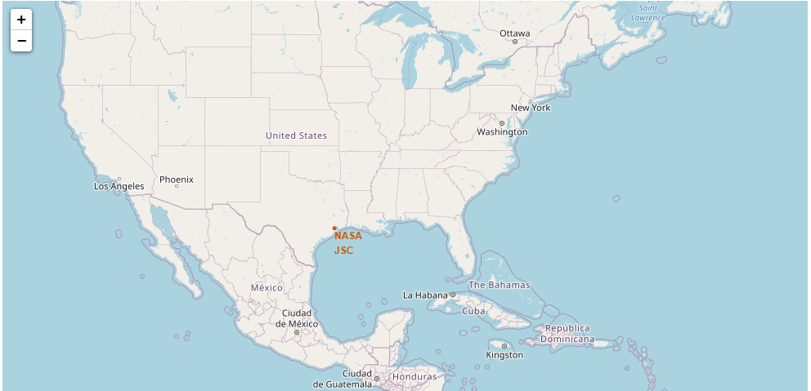
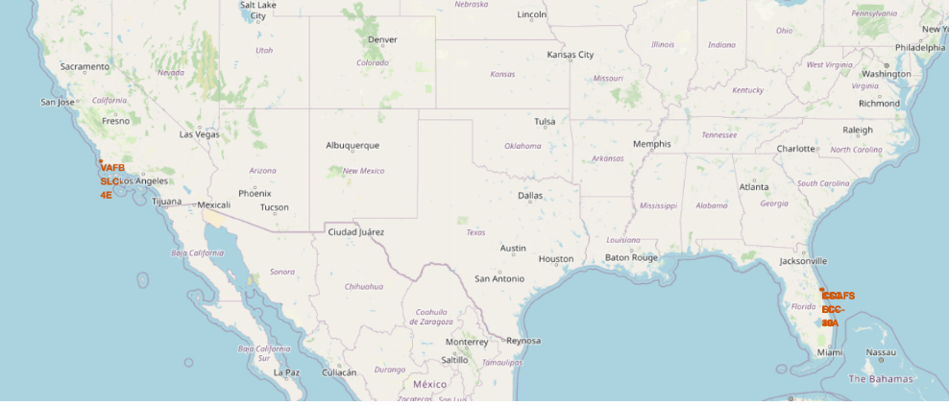
Build an Interactive Map with Folium

Slide 14
Build a Dashboard with Plotly Dash
The Plotly Python graphing library is a scientific graphing library. Graphs can be styled with Python and a GUI, and shared with a URL for others to view, collaborate, or save a copy
Plotly provides online graphing, analytics, and statistics tools for individuals and collaboration, as well as scientific graphing libraries for Python, R, MATLAB, Perl, Julia, Arduino, and REST

Slide 15
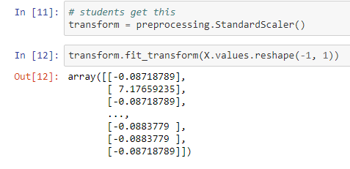
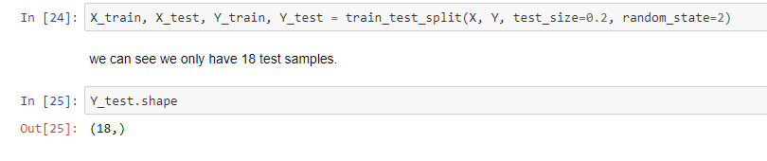
Predictive Analysis (Classification)
Predictive analytics is an applied field that uses a variety of quantitative methods that make use of data in order to make predictions.
The predictive analysis makes predictions on what might happen in the future using historical data. The data is gathered in base table which is consist of three important components: population, the candidate predictors and target.
GitHub URL

Slide 16
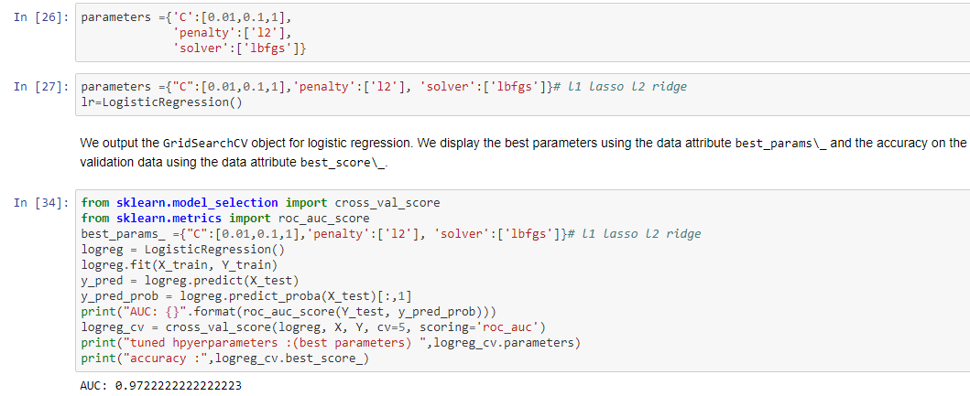
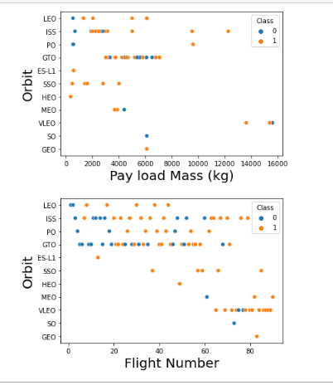
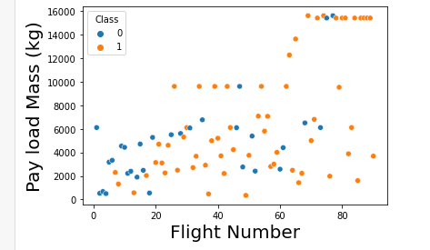
Results

Slide 17


Slide 18
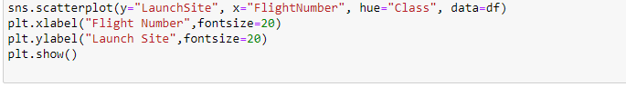
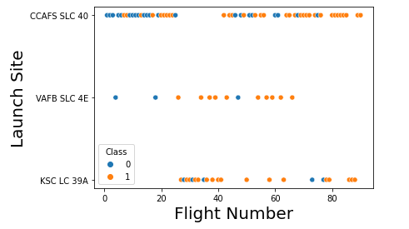
Flight Number vs. Launch Site
A scatter plot of Flight Number vs. Launch Site

Slide 19
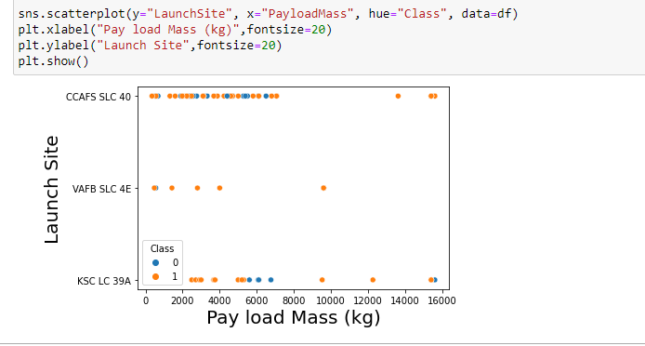
Payload vs. Launch Site
Show a scatter plot of Payload vs. Launch Site

Slide 20
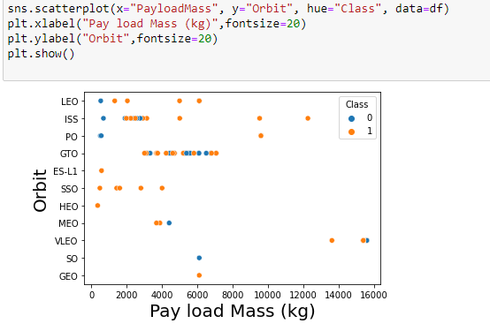
Payload vs. Orbit Type
Show a scatter point of payload vs. orbit type

Slide 21
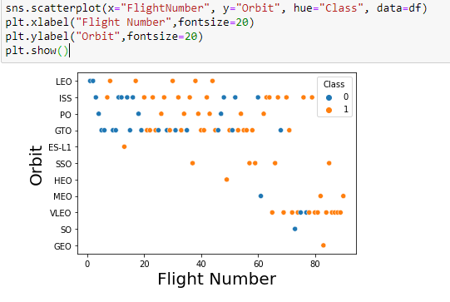
Flight Number vs. Orbit Type
Show a scatter point of Flight number vs. Orbit type

Slide 22


